Slide 1
广东省成人高考专用教材
（高中起点升本、专科）
英 语
讲师：梁晓亮

Slide 2
第三章 语法 第三节 名词 P46
第三节 代词
代词是用来代替名词或名词短语的词,按其意义、特征及其在句中的作用分为人称代词、物主代词、指示代词、反身代词、疑问代词、不定代词和关系代词等、人称代词

Slide 3
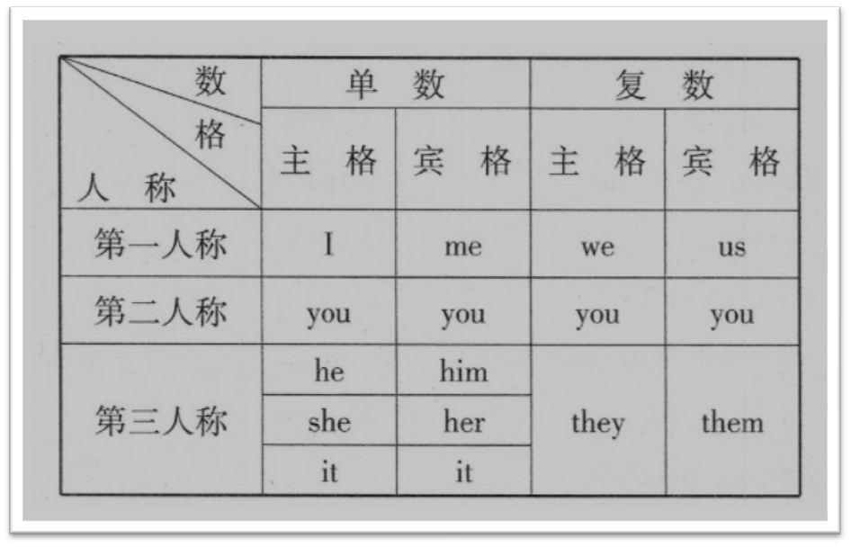
第三章 语法 第三节 名词 P46
1.人称代词的人称、数和格,如下表所示。

Slide 4
第三章 语法 第三节 名词 P46
2.人称代词有主格和宾格之分。通常主格作主语,宾格作宾语。
I like table tennis.(I作主语)
Do you know him?(him作宾语)
3.人称代词还可作表语,作表语时用宾格。
Who's is knocking at the door?
It's me.

Slide 5
第三章 语法 第三节 名词 P46
4.人称代词在than之后与其他人或事物进行比较时,用主格或宾格都可以。
He is older than me.
He is older than I

Slide 6
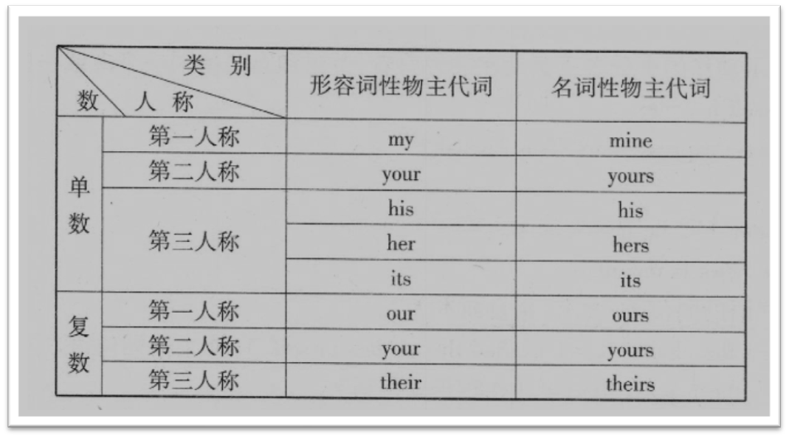
第三章 语法 第三节 名词 P47
二、物主代词
1.表示所有关系的代词叫物主代词。物主代词分为形容词性物主代词和名词性物主代词,如下表所示

Slide 7
第三章 语法 第三节 名词 P47
2.形容词性物主代词相当于形容词,可在句中作定语。
Our teacher is coming to see us.
This is her pencil-box.
3.名词性物主代词相当于名词,可在句中作主语、宾语和表语。
Our school is here, and theirs is there.(作主语)
--Is this English- book yours?(作表语)
--No Mine is in my bag.
I’ve already finished my homework. Have you finished yours?(作宾语)

Slide 8
第三章 语法 第三节 名词 P47
三、指示代词
指示代词包括:this, that, these, those。
1.如this和these一般用来指在时间或室间上较近的事物或人,that和those则指时间或空间上较远的事物或人。
This is a pen and that is a pencil.
We are busy these days.
In those days the workers had a hard time.

Slide 9
第三章 语法 第三节 名词 P47
2.有时that和 those指前面讲过的事物,this和 these则指下面将要讲到的事物
I had a cold. That's why I didn't come.
What I want to say is this: Pronunciation is very important in learning English.

Slide 10
第三章 语法 第三节 名词 P47
3.有时为了避免重复提到的名词，常可用that或those代替
Television sets made in Beijing are just as good as those made in Shanghai.
4.this在电话用语中代表自己,that则代表对方。
Hello! This is Mary. Is that Jack speaking

Slide 11
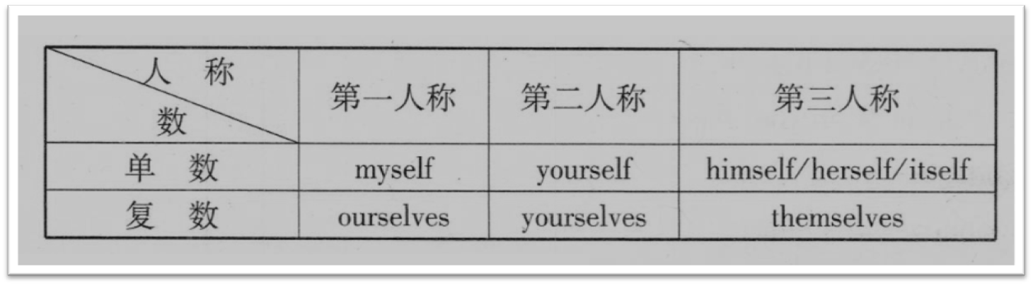
第三章 语法 第三节 名词 P47
四、反身代词
英语中用来表示“我自己”、“你自己”、“他自己”、“我们自己”、“你们自己”等意义的代词称为反身代词,也有人称之为自身代名词,其形式如下表所示

Slide 12
第三章 语法 第三节 名词 P48
反身代词可以在句中作宾语、表语、同位语。
1.作宾语,表示动作的承受者就是动作的发出者,主语和宾语指同一个人或一些人。
He called himself a writer.
Would you please express yourself in English?
2.作表语
It doesn't matter. I'll be myself soon.
The girl in the news is myself.

Slide 13
第三章 语法 第三节 名词 P48
3.作主语或宾语的同位语,表示“亲自或本人”
I myself washed the clothes.(= I washed the clothes myself.)(作主语同位语)
You should ask the teacher himself.(作宾语同位语)

Slide 14
第三章 语法 第三节 名词 P48
五、不定代词
用来代替不具体的某个或某些名词的代词叫作不定代词,在句中可作主语、表语、宾语和定语。
现将几个常用的不定代词举例说明如下：

Slide 15
第三章 语法 第三节 名词 P48
1.some与any的区别
(1)some多用于肯定句,表示“一些、几个”。作形容词时,后面可以接不可数名词或可数名词。
Some rice in the bag has been sold out.
Look! Some of the students are cleaning the library.

Slide 16
第三章 语法 第三节 名词 P48
(2)any多用于疑问句、条件句和否定句中，表示“一些、任何”。作形容词时，后面可以接不可数名词或可数名词
If you have any questions, please ask me.
There isn't any orange in the bottle.
Have you got any tea?

Slide 17
第三章 语法 第三节 名词 P48
(3)any和some也可以用作代词,表示“一些”any多用于疑问句或否定句中，some多用于肯定句中。
How many people can you see in the picture?
I can't see any.
If you have no money, I'll lend you some.
注意:与some, any结合的词,如something: somebody, someone, anvthing, anyone,anybody在肯定句、否定句、疑问句、条件句中的用法,大致和some ,any的用达相同。

Slide 18
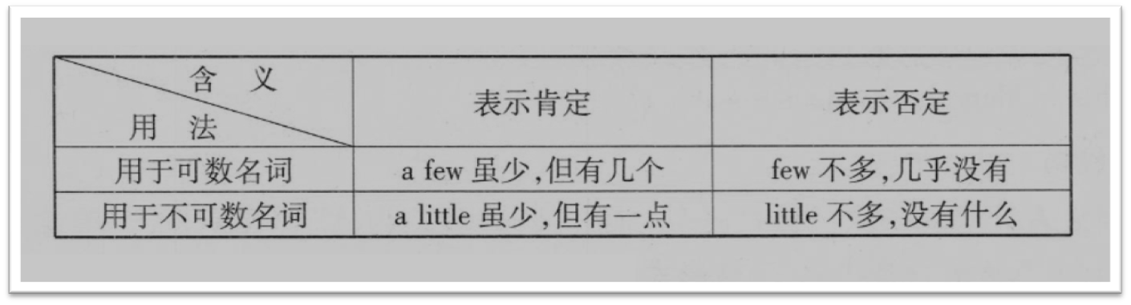
第三章 语法 第三节 名词 P48
2.few,a few, little, a little的区别
(1)用作形容词。

Slide 19
第三章 语法 第三节 名词 P48
I'm going to buy a few apples.
He can speak only a little Chinese.
There is only a little milk in the glass.
He has few friends.
They had little money with them.

Slide 20
第三章 语法 第三节 名词 P48
(2)a little和little也可以用作副词,a little表示“有点稍微”，little表示“很少”
I'm a little hungry.
Let him sleep a little.
Mary, go a little faster, please.
She slept very little last night.

Slide 21
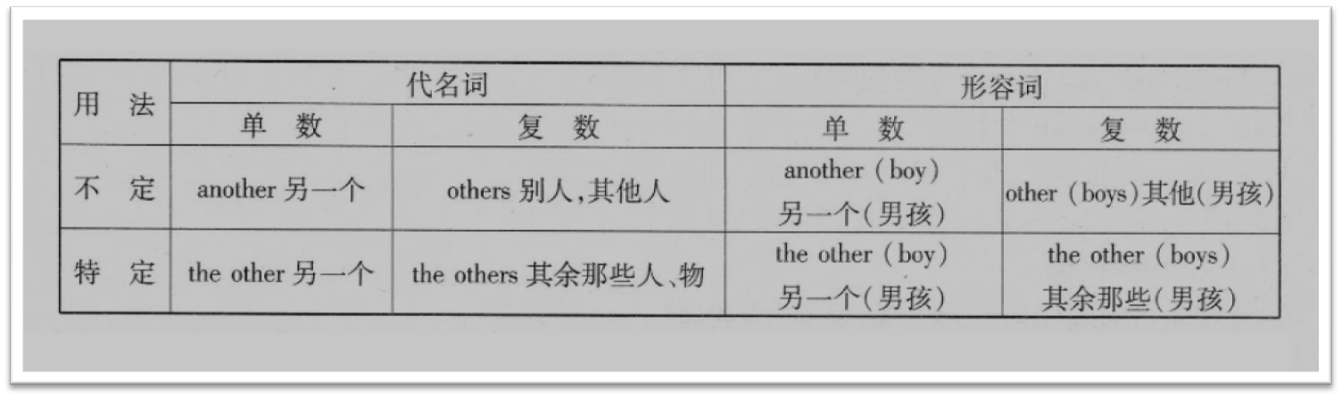
第三章 语法 第三节 名词 P49
3. other, the other, another, others, the others的区别

Slide 22
第三章 语法 第三节 名词 P49
(1) other可以用作形容词,后面可以跟单数或复数名词,意思是“其他的、别的”。
Where are his other books?
I haven t any other books except this one.

Slide 23
第三章 语法 第三节 名词 P49
(2) other也可以用作代词,与冠词the连用构成“ the other”表示两个人或物中的“另一个”。常与one搭配构成“ one...the other...”句型
He has two brothers. One is 10 years old, the other is 5 years old.
She held a ruler in one hand and an exercise-book in the other.

Slide 24
第三章 语法 第三节 名词 P49
(3)other用作代词时,复数形式为others”,泛指“另外的人或物”常与some搭配构成“some...others...”句型。
Some went to the cinema, others went swimming.
This coat is too large. Show me some others, please.

Slide 25
第三章 语法 第三节 名词 P49
(4)“ the others”表示特指某范围肉的“其他的人或物”
We got home by 4 o'clock, but the others didn't get back until 8 o'clock.
In our class only Tom is English, the others are Chinese.

Slide 26
第三章 语法 第三节 名词 P49
(5) another可以用作形容词,修饰后面的名词,意为“另一个”,还可以跟代词one。
You can see another ship in the sea, can't you?
Mary doesn’t want to buy this skirt. Would you please show her another one?
(6) another也可以用作代词,表示“另一个”。
I'm still hungry after I've had this cake. Please give me another.

Slide 27
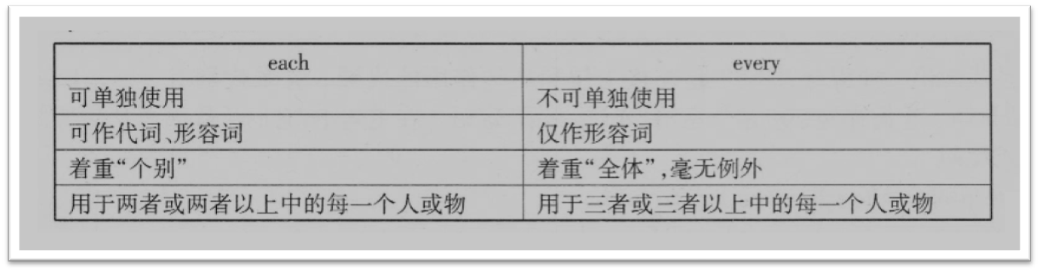
第三章 语法 第三节 名词 P49
4. every与each的区别

Slide 28
第三章 语法 第三节 名词 P49
The teacher gave a toy to each child.
Each ball has a different color.
当我们说 each child, each student或 each teacher时,我们想到的是一个人的情况,而当我们说
every child和 every student时我们想到的是全体的情况ever的意思与叫接近表示“都如此”。
Every student loves the English teacher.= All students love the English teacher.
Every child likes playing. = All children like playing.

Slide 29
第三章 语法 第三节 名词 P50
5.all和both的用法
(1)all指三者或三者以上的人或物,或者不可数的东西。谓语动词既可以用单数,也可以用复数,在句中作主语、表语、宾语、同位语和定语。
All of us like Mr. Pope.我们都喜欢Pope先生。(作主语)
= We all like Mr. Pope.(作同位语)
That's all for today.(作表语)
Why not eat all(of) the fish?(作宾语)
All the leaders are here.(作定语)

Slide 30
第三章 语法 第三节 名词 P50
(2)both用作代词。
①与其他名词或代词并列出现,表示“两者都”。
Lucy and Lily both agree with us.
They both passed on their sticks at the same time.
How are your parents? They re both fine.

Slide 31
第三章 语法 第三节 名词 P50
②与“of+代词(或名词)”连用,表示“两者都”。
Both of them came to see Mary.
Both of the books are very interesting.
③单独使用,表示“两者都”。
Michael has two sons. Both are clever.
I don' t know which book is the better: I shall read both.
(3)both用作形容词,放在名词之前,修饰该名词,表示“两者都”。
Both his younger sisters are our classmates.
There are tall trees on both sides of the street.

Slide 32
第三章 语法 第三节 名词 P50
六、疑问代词
疑问代词有who, whom, whose, what和 which等。疑问代词用于特殊疑问句中,一般都放在句首,并在句子中作为某一句子成分。
Who is going to come here tomorrow?(作主语)
What is that?(作表语)
Whose umbrella is this?(作定语)
Whom are you waiting for?(作宾语)

Slide 33
第三章 语法 第三节 名词 P50
七、关系代词
关系代词是一种引导从句并起连接主句和从句作用的代词。关系代词有who, whose, whom, that, which等。它们在句中可用作主语、表语、宾语、定语。在主句中,它们还代表着从句所修饰的那个名词或代词。
I hate people who talk much but do little.
I' m looking at the photograph which you sent me with your letter.
With the money that he had saved, he went on with his studies.
Do you know the lady who is interviewing our headmaster?

Slide 34
第三章 语法 第三节 名词 P51
八、it的用法
it作为人称代词,常用来表示动物或无生命的物体等。此外,它在句子中只充当句子中形式上的成分,如形式主语、宾语、表语等,这时,并不具有自身的意义与内容。it也可以作为无人称代词,在句子中作主语,表示“时间”、“距离”、“任何自然现象”等。让还可以引导强调句,使语气得以加强。

Slide 35
第三章 语法 第三节 名词 P51
1.it作无人称代词的用法
(1)表示时间等。
-What time is it by your watch? --你的表几点了?
-It is two thirty--两点半。
It was some time before he appeared.一段时间后他才出现。
It's time for meeting. Let's go.开会的时间到了,我们走吧!

Slide 36
第三章 语法 第三节 名词 P51
(2)表示距离、情况等,一般用作无人称动词的主语。
It is very near from this factory to that one.从这个工厂到那个工厂非常近。
Is it well with you?你身体好吗?
It is more than ten miles from here to the station.从这儿到车站有十多英里路。
It is ten minutes‘ walk.要走十分钟。

Slide 37
第三章 语法 第三节 名词 P51
(3)表示自然现象、气候等。
It is rather warm today.今天相当暖和。
It often rains in summer and it often snows in winter in this city.
这个城市夏天经常下雨,冬天经常下雪。

Slide 38
第三章 语法 第三节 名词 P51
2.it作人称代词可指一般动物和无生命的东西。
(1)指前面的名词。
The dog is in the garden, isn't it?狗在花园里,是吗?
Where is my pen? I can't find it.我的钢笔在哪里?我找不着了。

Slide 39
第三章 语法 第三节 名词 P51
(2)指前面的句子。
She is weak at spoken English and she realized it.她的英语口语很差,她意识到了这一点。
He decided to do exercises every morning, but couldn‘t keep it up.他决定每天做早操,但又不能坚持。

Slide 40
第三章 语法 第三节 名词 P51
(3)作形式主语,代替后面的动名词、不定式、短语或句子所表示的真正主语。
It is difficult to climb a mountain爬山是难的。
It is dangerous playing with fire.玩火是危险的。
It is a pity that you didn't see such a good film.你没有看这么好的影片,真可惜。
It is said that the plane will take off at ten tomorrow morning.
据说飞机明天上午十点起飞。

Slide 41
第三章 语法 第三节 名词 P51
(4)作形式宾语,代替由不定式、动名词或从句所表示的真正宾语
She feels it her duty to help others.她觉得帮助别人是她的责任。
I thought it no use talking to him about it..我认为和他谈这事没用。
They want to make it clear to the public that they do an important and necessary job.
他们想要向公众表明,他们做的是重要而不可缺少的工作。
I think it foolish of you to worry about it.我认为你为此而担忧是愚蠢的。

Slide 42
第三章 语法 第三节 名词 P51-52
3.用以引导强调句型,可以对句子中的成分加以强调,旨在加强语气,常用强调结构:“It is(was)+被强调部分+that(who)…”
It was I who met your brother at the station yesterday.是我昨天在车站遇见你哥哥的。
It is French that we have been learning these years.这些年我们一直在学法语。
It was with great care that they did the job.他们极认真地完成这份工作。
It is the people who/ that are really powerful.真正强大的是人民
It was here that i first met him.这就是我初次与他见面的地方。

